Slide 1
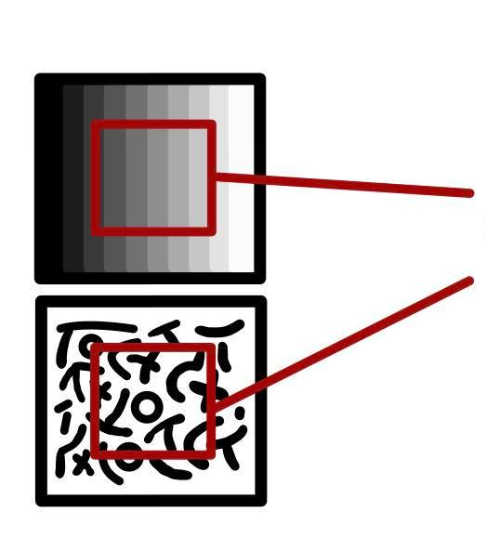
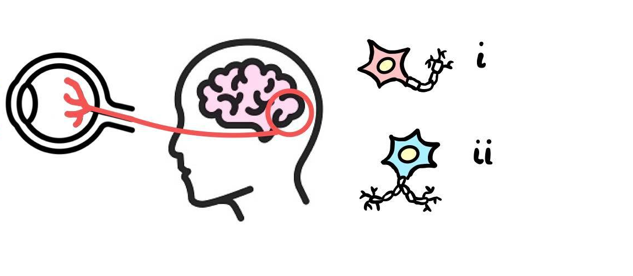
Luminescence (First Order)
Primary Visual Cortex
Simple Cells
Visual Texture
Complex Cells
Receptive Fields
Texture (Second Order)

Slide 2
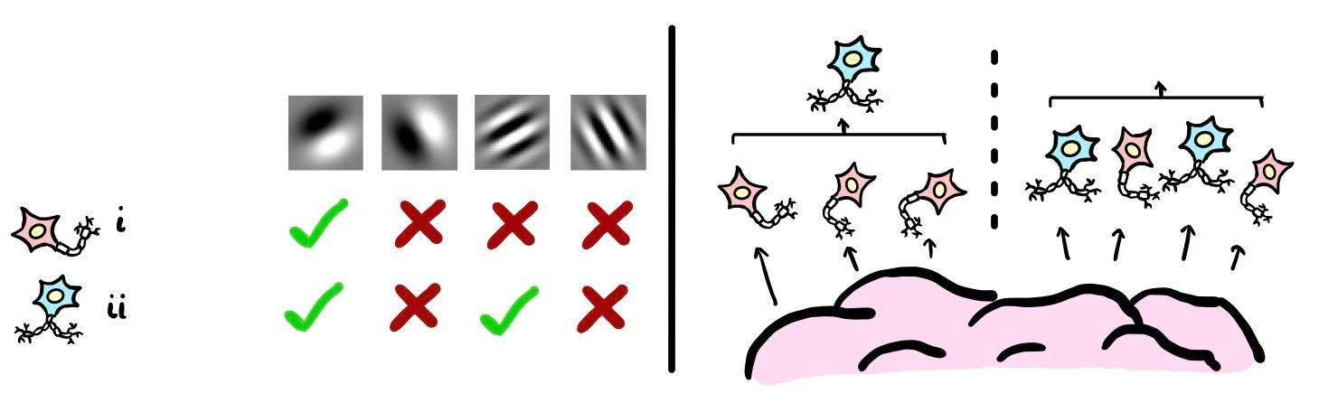
Hierarchical Structure
Parallel Structure
Different Orientation
Ideal Spatial Phase
Ideal Orientation
Ideal Spatial Phase
Ideal Orientation
Different Spatial Phase
Different Orientation
Different Spatial Phase
V1 Neuron Type
Simple
Complex
LGN of Thalamus

Slide 3
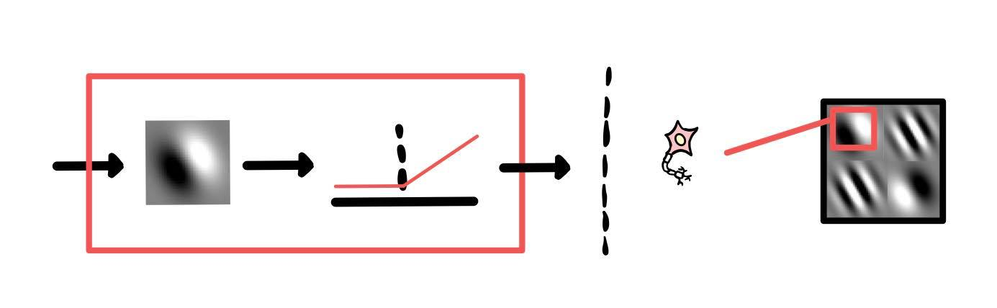
Simple Cell
LGN of
Thalamus
Non-Linear Function
Specific Orientation
Specific Spatial Phase
Linear Filter

Slide 4
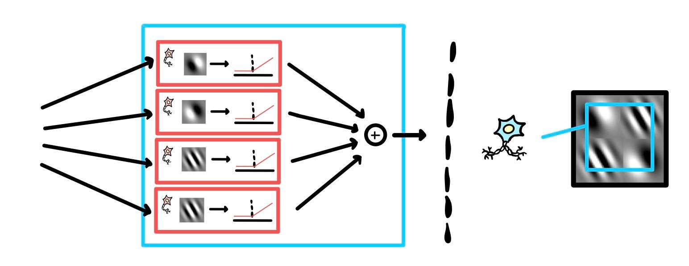
Complex Cell
LGN of
Thalamus
Specific Orientation
Non-Specific Spatial Phase
Hierarchical Summation of Simple Cells

Slide 5
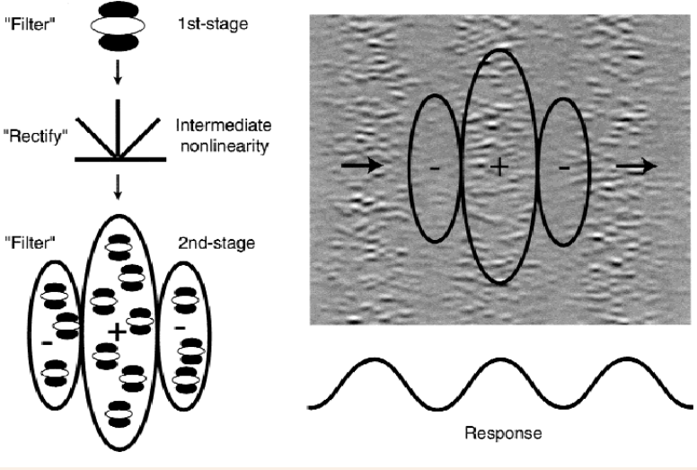

Slide 6






SMALL DATASET
6x6 Gabor Patches
MEDIUM DATASET
8x8 Gabor Patches
Large DATASET
10x10 Gabor Patches
Signal
No Signal
Signal
No Signal
Signal
No Signal

Slide 7
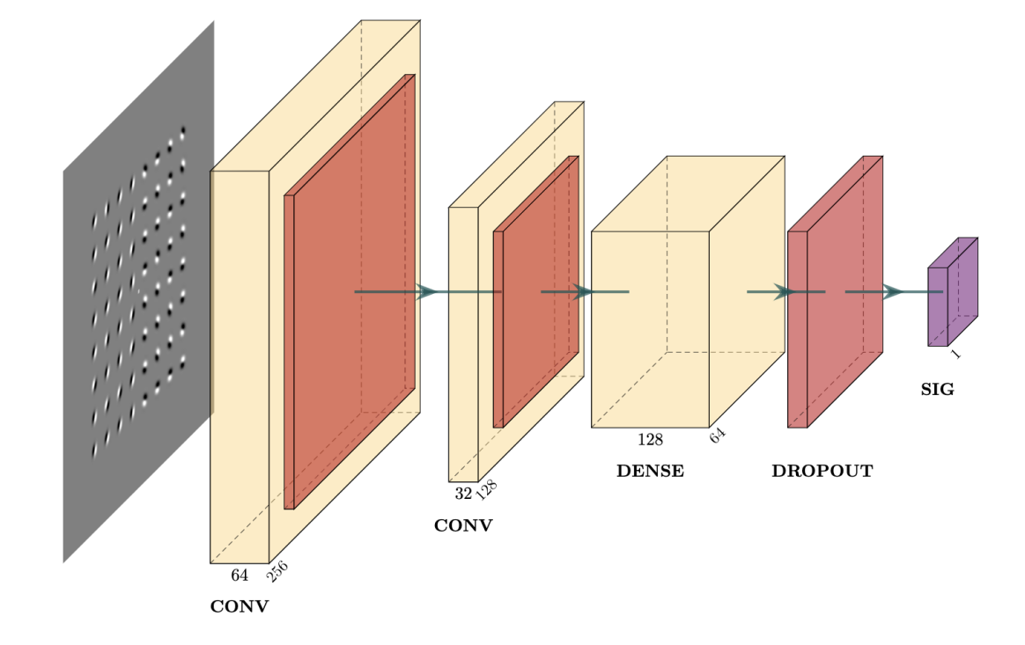
Addition of Dropout Layer
Data Augmentation
Original Model
Model after Dropout Layer
No change
Vertical Mirror
Horizontal Mirror
Horizontal & Vertical Mirror

Slide 8
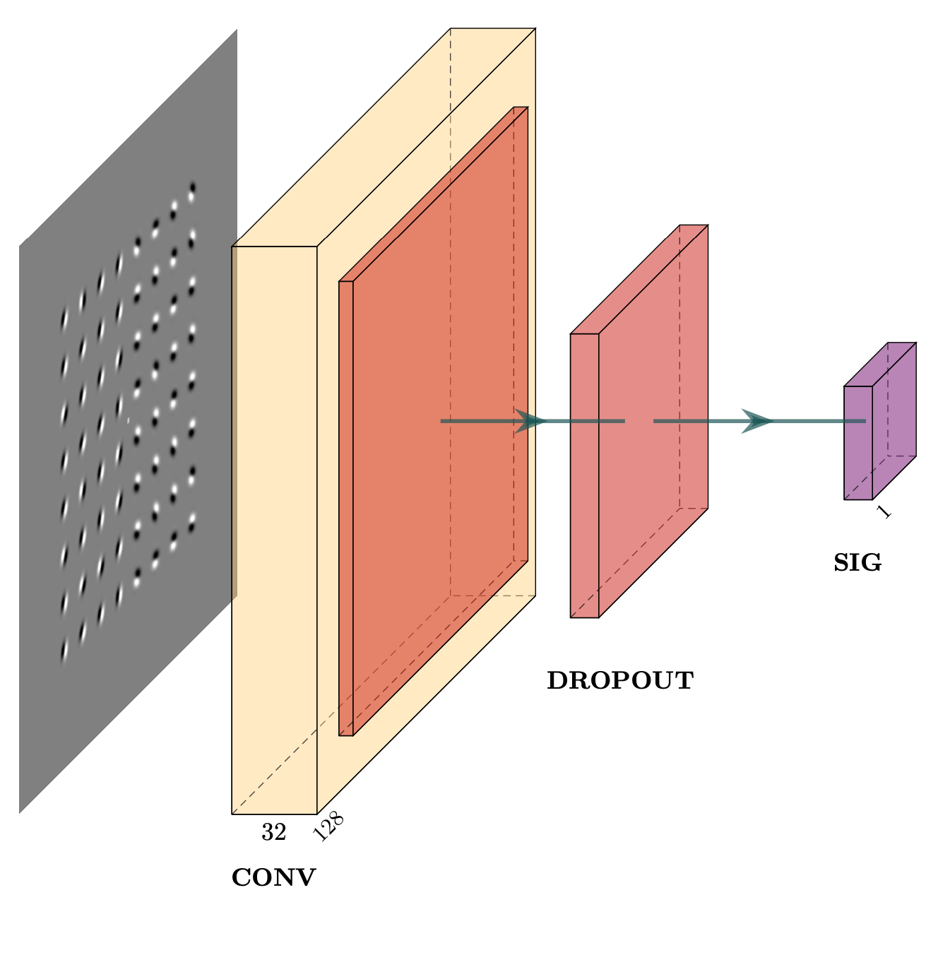
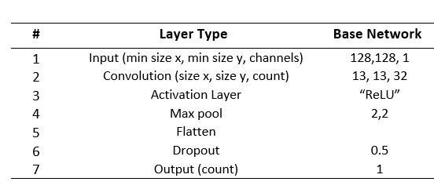

Slide 9
5x5 Pixel Size
9x9 Pixel Size
13x13 Pixel Size
17x17 Pixel Size

Slide 10
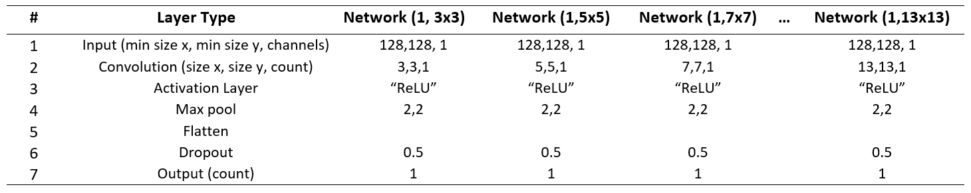
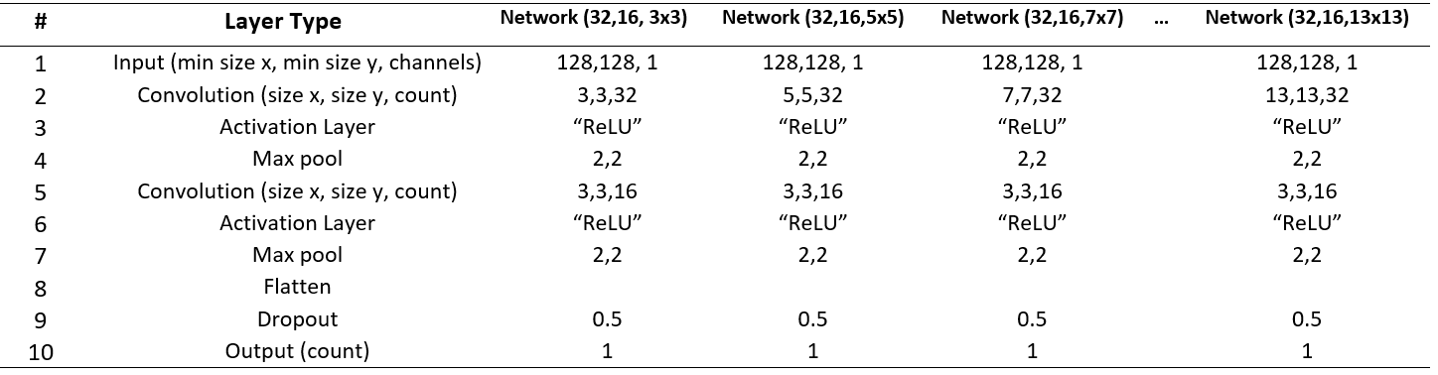
Single Neuron Model
Dual Layer Models

Slide 11
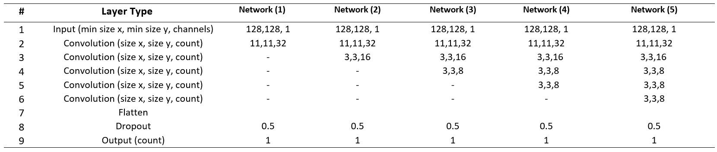
Note: All convolutional layers followed by a ‘ReLU’ activation function and a max pooling layer

Slide 12




Horizontal Boundary Datasets
Diagonal Boundary Datasets
Offset Boundary Datasets

Slide 13
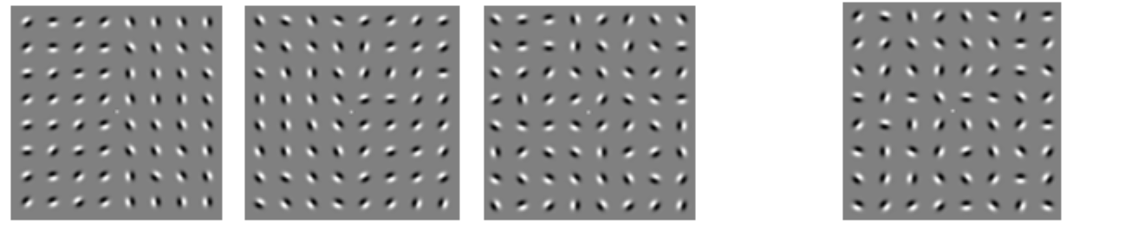
SIGNAL (Increasing Noise Level)
NO SIGNAL

Slide 14
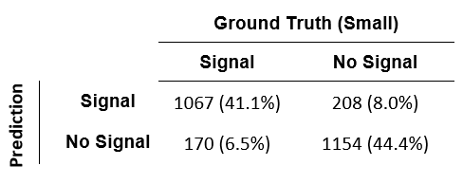
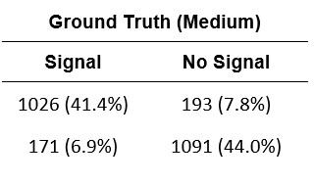
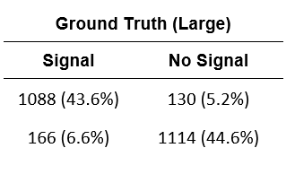

Slide 15
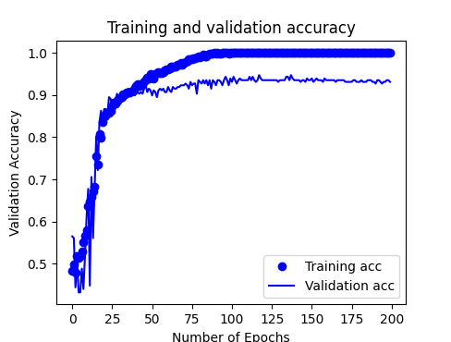
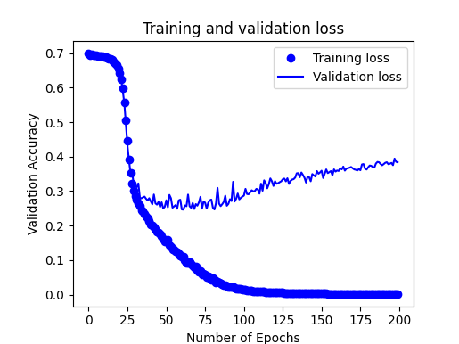
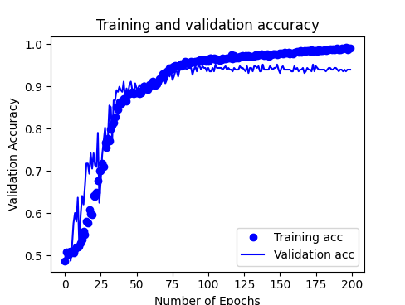
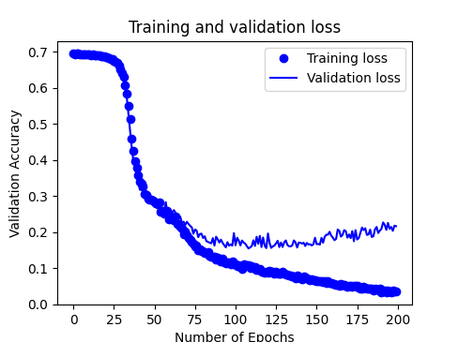
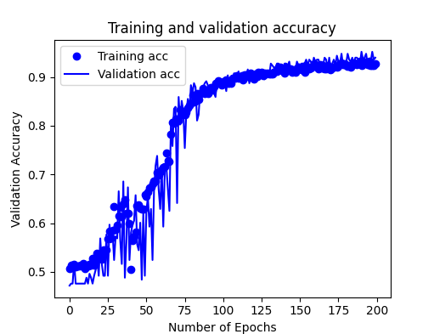
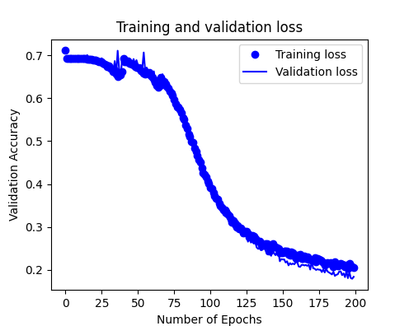
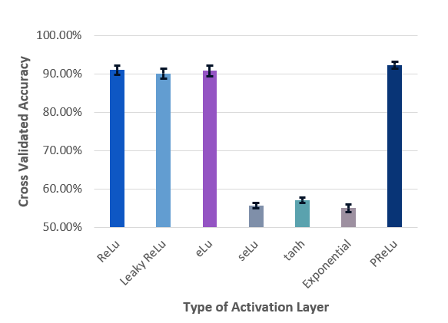
Before Overfitting Corrections
After Overfitting Corrections
Validation Accuracy (%)
Validation Accuracy (%)
Validation Loss
Validation Loss
Final Model Training Sequence
Activation Layer Analysis
Validation Accuracy (%)
Validation Loss

Slide 16
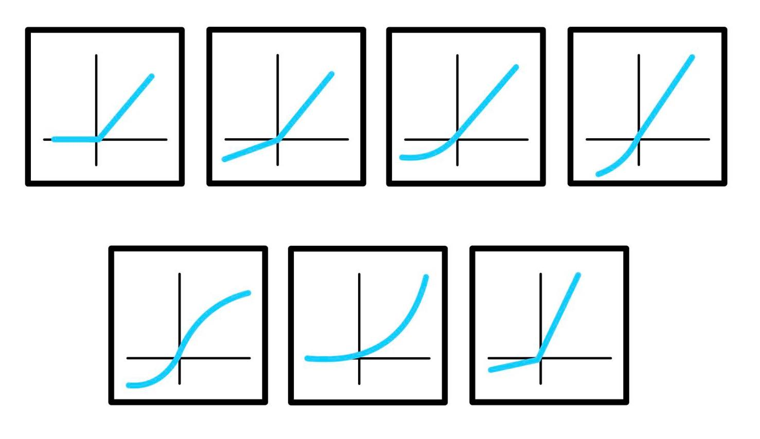
ReLU
Leaky ReLU
eLU
seLU
tanh
Exponential
pReLU

Slide 18
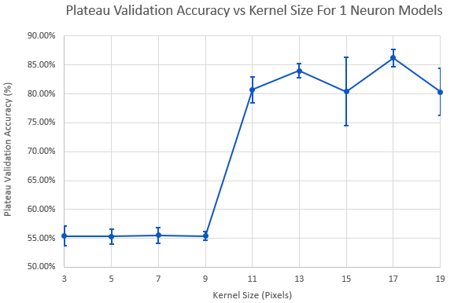
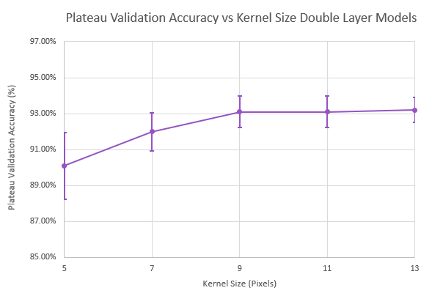

Slide 19
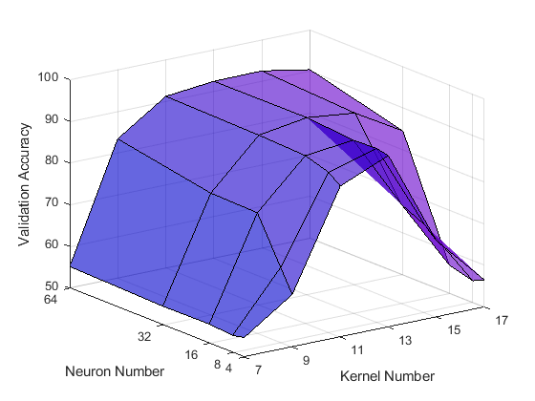

Slide 20
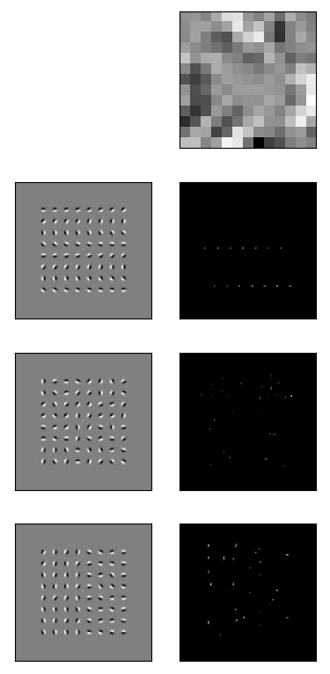
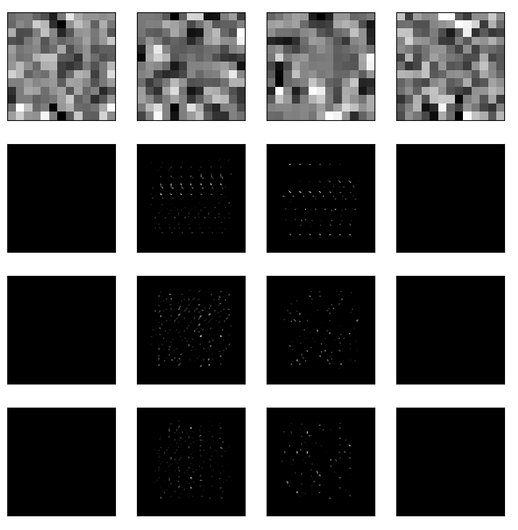
1 Neuron
4 Neurons
Angle Array
No Signal
Signal

Slide 21
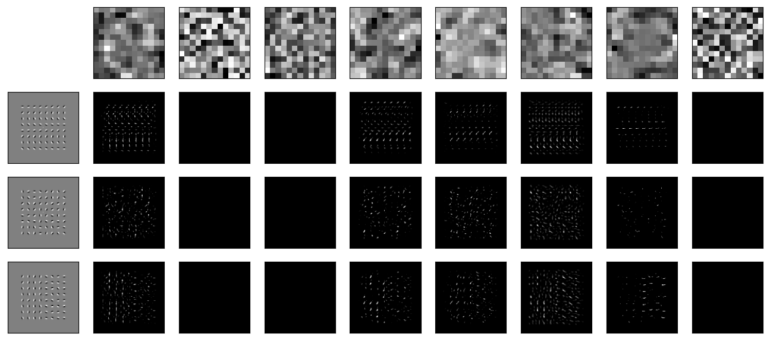
Orientation Specific
Spatial Summation
Noise
Angle Array
No Signal
Signal

Slide 22
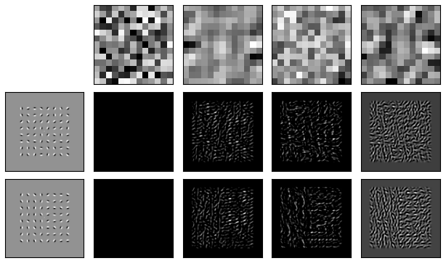
Noise
Spatial Summation
No Signal
Signal

Slide 23
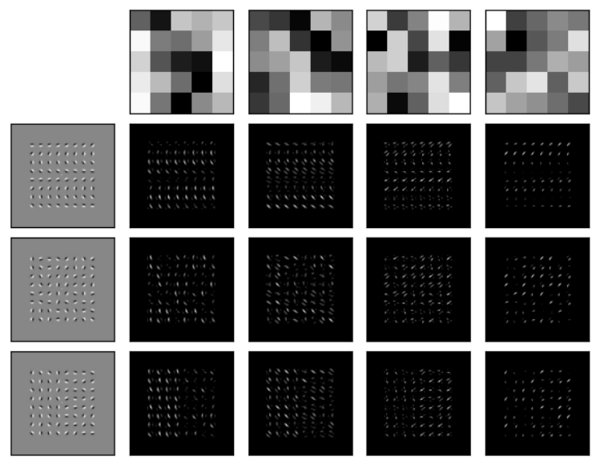
Angle Array
No Signal
Signal

Slide 24
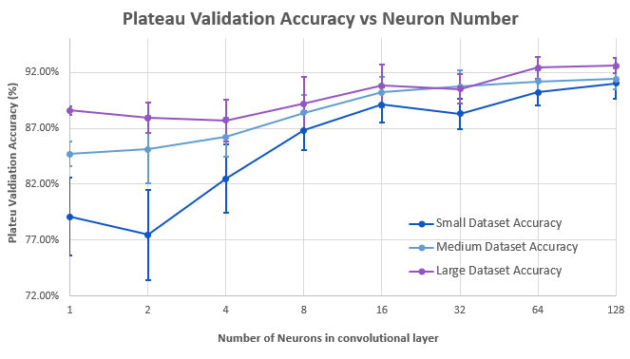

Slide 25
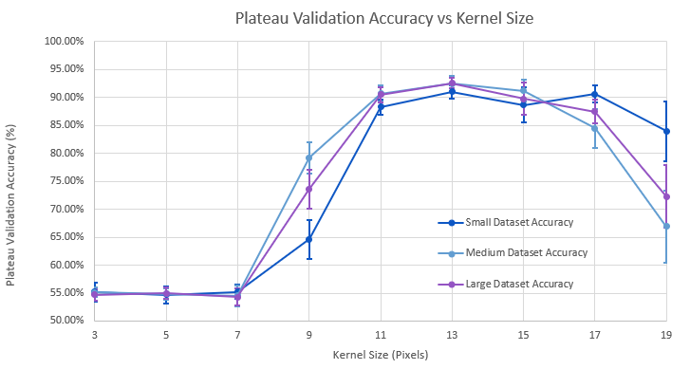

Slide 26
